Slide 1

Java Script

Slide 2
Limitations of HTML
Cannot respond to user
It cannot make decision
Cannot automate repetitive tasks

Slide 3
Scripting Lang Vs Programming Lang
Scripting languages are generally interpreted languages
Programming languages are generally complex while scripting languages are simple.
They have simple syntax and can perform tasks and are easy to learn
Web scripting allow u to combine HTML with Script
Web script generally execute in web browser

Slide 4
List of web scripting Lang
Java script
Jscript
VB script
PHP

Slide 5
Capabilities of Java script
It is the first web scripting Lang and most popular
Validate the contents of a form
Display messages to user(as web page/alert boxes)
Animate images and making menus
Detect browser and adjust accordingly
Detect installed plug in and notify user if new required
Adding scrolling text to browser status line
Event Handling

Slide 6
Alternatives to java script
Java—Applets
Activex:- specification developed by Microsoft
VB script:
CGI and server side scripting:specification
A server side implementation of java script is also available

Slide 7
Simple HTML page
<html><head>
        <title>my Page Tile</title>
        Welcome to the world of HTML
    </head>
<Body><hr>my page body</body>
<html>
Simple Html page.html

Slide 8
First java script page
<BODY>
<hr>my page body
<SCRIPT language="JavaScript">
document.write(document.lastModified);
</SCRIPT>
</BODY>
Simple javaScript page.html

Slide 9
Where to place java script
In Body of the HTML page
In the header of the page<HEAD></HEAD>
With in an HTML tag i.e without <SCRIPT> tag
In separate file with .js extension

Slide 10
Window objects
Window.status Property
Window.prompt()
Window.alert()
Window.confirm()
Window.open(“URL”,”TITLE”,”Featured list”);
Window.close()
M
E
T
H
O
D
s
Examples
alert.html window status bar.html confirm.html
prompt.html
winOpen.html

Slide 11
History object
History.back()
History.forward()
History.go(-2) Equivalent to pressing back button twice

Slide 12
Data types in java script
Numbers such as 3,45,1.34 i.e. both integer and float
Boolean or logical values
String such as “Hello user”
null..this is the value of an un initialized number
String str=“40”;
eval(str);
parseInt(str);
parseFloat(str);
sum of 4 nos.html

Slide 13
Variable Declaration
Although it is often unnecessary, it is good programming style to declare variables before using them.
        var i;
        var sum;
declare multiple variables with the same var keyword:
        var i, sum;
And you can combine variable declaration with initial assignment to the variable:
        var i = 2;

Slide 14
Java Script Operator
Addition Operator
The addition operator is a binary operator. The syntax is
operand1 + operand2
Assignment Operator
The assignment operator is a binary operator. The syntax is
operand1 = operand2

Slide 15
Operators Continue…
Bitwise AND Operator
The bitwise AND operator is a binary
operator. The syntax is
operand1 & operand2
Bitwise Exclusive-Or (XOR) Operator
The bitwise exclusive-or (XOR) operator is a binary operator. The syntax is
operand1 ^ operand2

Slide 16
Operators Continue…
Bitwise OR Operator
The bitwise OR operator is a binary operator. The syntax is
operand1 | operand2
Bitwise Negate Operator
The bitwise negate operator is a unary operator. The syntax is
~ operand1

Slide 17
Operators Continue…
Concatenation Operator
The concatenation operator is binary. The syntax is
operand1 + operand2
Conditional Operator
The conditional operator is the only ternary operator. The syntax is
operand1 ? operand2 : operand3

Slide 18
Operators Continue…
Division Operator
The division operator is binary. The syntax is
operand1 / operand2
Equality Operator
The equality operator is binary. The syntax is
operand1 == operand2

Slide 19
Operators Continue…
Greater Than or Equal/Lass Than or Equal Operator
The greater than or equal operator is binary. The syntax is
operand1 >= operand2
operand1<= operand2

Slide 20
Operators Continue…
Inequality Operator
The inequality operator is binary. The syntax is
operand1 != operand2

Slide 21
Operators Continue…
Logical AND Operator
The logical AND operator is binary. The syntax is
operand1 && operand2
Logical OR Operator
The logical OR operator is binary. The syntax is
operand1 || operand2

Slide 22
Operators Continue…
Modulo Operator
The modulo operator is binary. The syntax is
operand1 % operand2

Slide 23
Operators Continue…
Pre-Increment/Post-Increment
Post-Decrement/Post-Decrement
++ operand/operand ++
-- operand/operand –
Shift-Left Operator/Shift-Right Operator
operand1 << operand2
operand1 >> operand2
Zero-Fill Shift Right Operator
operand1 >>> operand2

Slide 24
Event handler
You don't need the <script > tag
<a href="mailto:brsn02@yahoo.com" onmouseover="window.alert('you moved over the link');">mailto-brsn college
</a>
event handler.html

Slide 25
Mouse Events
Events
onMouseOver()
onMouseOut()
onMouseUp()
onMouseDown()
onMouseMove()
onClick()
Examples
onMouseOver.html

Slide 26
Timeouts
I=Window.setTimeout(“command”,time);
Window.clearTimeout(I);
Example
timeout.html

Slide 27
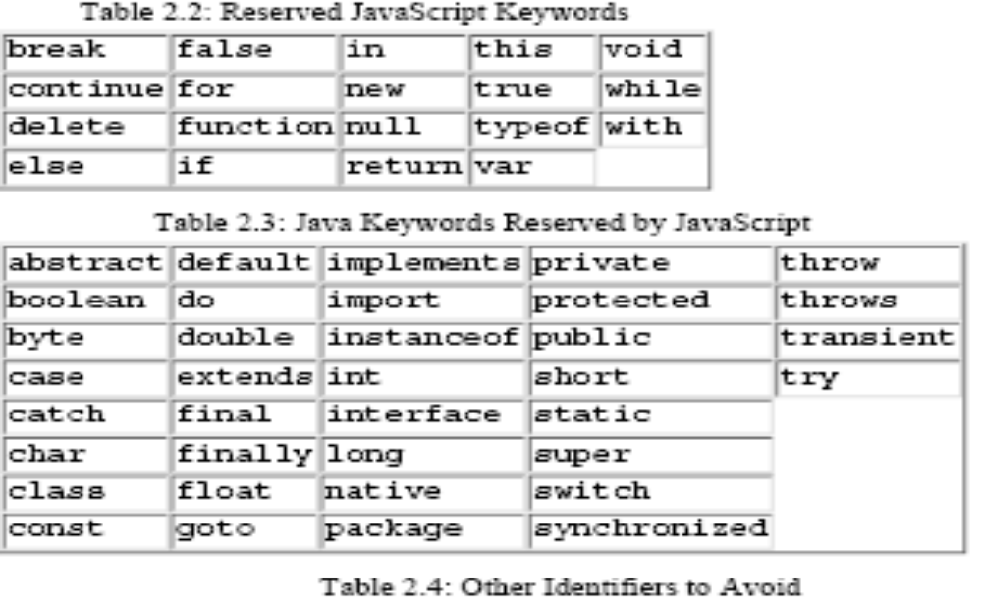
Reserved Words

Slide 28
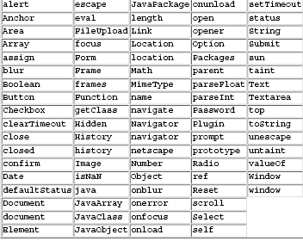
Continue…

Slide 29
First Program
<html>
<body>
<script type = "text/javascript">
var str = "Hello world!";
document.write("<p><center>The Upper Case :" + str.toUpperCase() + "</center></p>");
</script>
</body>
</html>

Slide 30
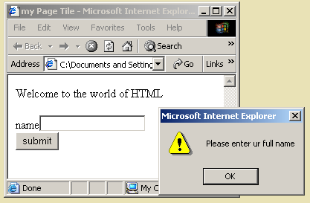
Validating a Form
Validate.html

Slide 31
References
The ATLAS JavaScript FAQ (http://www.freqgrafx.com/411/atlas/jsfaq. html) is Andy Augustine's excellent attempt at tracking Frequently Asked Questions about Netscape ATLAS, which will eventually become Netscape 3.0.
The Dead Eye Saloon (http://www.lhouse.com/~jbloomberg/stud/), a Web page game by Jason Bloomberg, is a good example of a game written in JavaScript.
Do You Have JavaScript in Your Browser? (http://www.cris.com/~raydaly/ javatell.html) is a cute little demo by Ray Daly. Try it out!
Doctor HTML (http://imagiware.com/RxHTML.cgi) is a very handy site. It will perform a number of validation checks on your Web page, including spell checking and verifying that your element tags are properly nested and contained. Particularly noteworthy is its ability to check your IMG tags and tell you how to set the WIDTH and HEIGHT attributes. Probably 90 percent of JavaScript pages that don't work fail because of the infamous "missing HEIGHT and WIDTH" bug.
Gamelan (http://www.gamelan.com/) is Earthweb's Java Directory. There are an impressive number of JavaScript links collected here, and it was one of the key sites I used to track down JavaScript details.
The hIdaho Frameset (http://www.hidaho.com/frameset/) is a set of functions written by Bill Dortch. The functions provide global function registration and a calling mechanism for multiframe applications. This is a very impressive body of work that is design to make life in multiframeset applications less of a headache.
How to Do Forms (http://www2.ncsu.edu/bae/people/faculty/walker/ hotlist/forms.html), written by Joseph C. Walker of North Carolina State University, contains a great deal of information about creating forms. Much of this material is beyond the scope of this book, so you should definitely check this site if you need help with forms. In particular, there is a wealth of information about creating the CGI scripts in Perl, which is one of the more popular scripting languages for writing CGI applications.
Jamie's Calculator (http://www1.mhv.net/~jamihall/calc2.html) is a calculator written in JavaScript. I almost included a chapter explaining how to construct a calculator, but after I saw this page, I gave it up. This is such an elegant solution, I just couldn't surpass it.
JavaScript 411 (http://www.freqgrafx.com/411/) is Andy Augustine's JavaScript Information home page. You could spend a day or two just following and reading the useful links from here.
The JavaScript FAQ (http://www.freqgrafx.com/411/jsfaq.html) is Andy Augustine's compilation of Frequently Asked Questions about JavaScript. This is a very useful page when you're struggling with code that you know should work but doesn't. It can be comforting to know that you've just tripped over a bug in the browser, that the problem is not your code, and that there's a workaround for the bug on this page.
The JavaScript Index (http://www.c2.org/~andreww/javascript/) is Andrew Wooldridge's index of JavaScript links. I learned a lot from browsing here.
Netscape's Frames Documentation (http://www.mcom.com/assist/ net_sites/frames.html) is a good introductory document on using FRAME and FRAMESET elements.
Netscape's JavaScript Authoring Guide (http://home.netscape.com/eng/ mozilla/2.0/handbook/javascript/index. html) is Netscape's online documentation of JavaScript for Netscape 2.0. This is the authoritative documentation for what's in this book. Just be careful: Not everything described in this site was actually implemented as described!
Netscape's JavaScript Authoring Guide (http://home.netscape.com/eng/ mozilla/3.0/handbook/javascript/) is Netscape's online documentation of JavaScript for Netscape 3.0. By the time you get this book in your hands, Netscape 3.0 should be right around the corner, if not already available. The new version of Netscape includes some neat things that I wished I could have used in this book.
The Snippet Library (http://www.freqgrafx.com/411/library.html) is Andy Augustine's ongoing effort to collect useful pieces of code that you can incorporate into your pages. I highly recommend checking out this site from time to time to see what's new.

